Slide 1


Evaluating the Effectiveness of Machine-Learning in Detecting AI-Generated Content
Sam Magee – B00132512

Slide 2
Introduction
AI-Content is a rapidly growing area of study and interest.
Involves the use of rapidly improving deep-learning models.
Field has progressed from text, to images, to now realistic video generation.

Slide 3
Research questions
How effective are current ML models at identifying AI-generated images?
What are the specific characteristics and anomalies that can be used to detect AI-generated content?
How do different ML model types & parameters perform under various conditions, and what are their limitations?

Slide 4
Evolution of AI-Generated Content
1950s – 1970s
Very early programs, Sketchpad for example. Film CGI – Westworld.
1980s – 1990s
CAD software, Autodesk. Fully CGI film, The Adventures of André & Wally B., Pixar.
1990s – 2000s
Early experiments using neural networks to both enhance and create images.
2010s
First development of GANs, first time we start seeing realistic generated content.
2020s
Introduction of diffusion models. Creation of highly realistic images now widespread.

Slide 5
Detection of AI-Generated Content
Early Approaches
Focused on detecting specific anomalies, such as JPEG compression & artifacts.
Methods
Watermarking – Prone to circumvention.
Anomaly-Based – More reliable but difficult to implement.

Slide 6
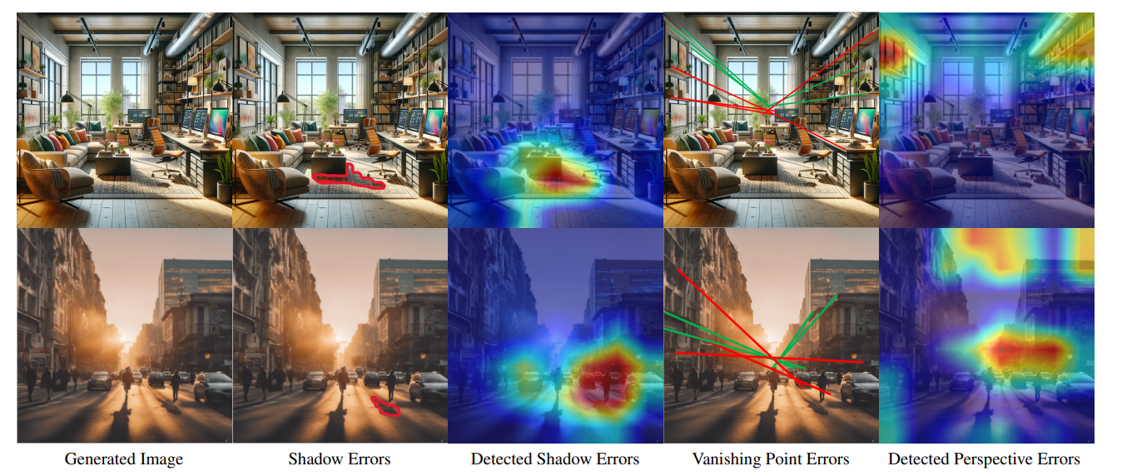
Anomaly-based detection
Autonomously identifies AIGC regardless of preset watermarks.
Looks for patters, geometric inaccuracies, pixel artifacts, noise patterns from the diffusion noise process.
Requires diverse datasets + Constant retraining on new datasets.
Varying effectiveness.

Slide 7
Methodology
5 Data sources for training.
Varied evaluation dataset for novel evaluation process.
Binary classification process, using labelled directories.

Slide 8
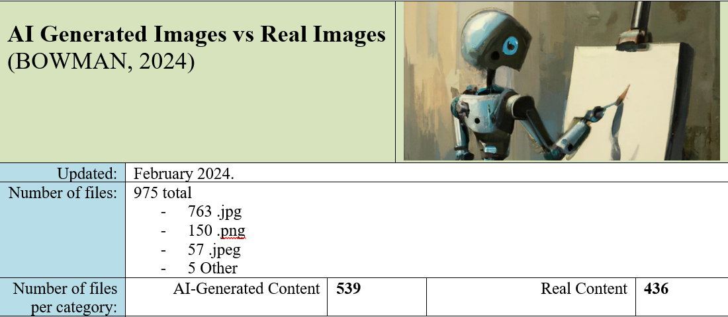

Slide 9
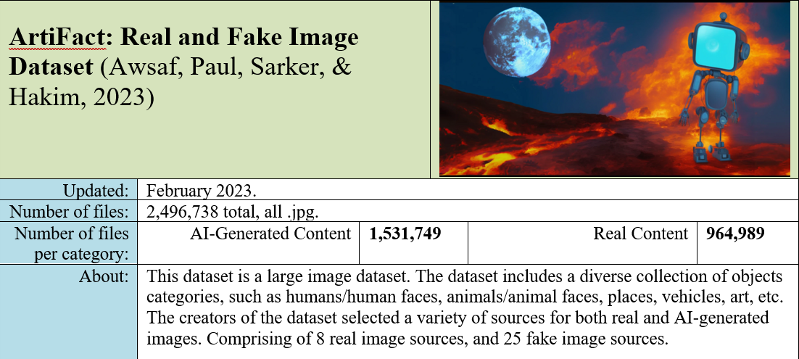

Slide 10
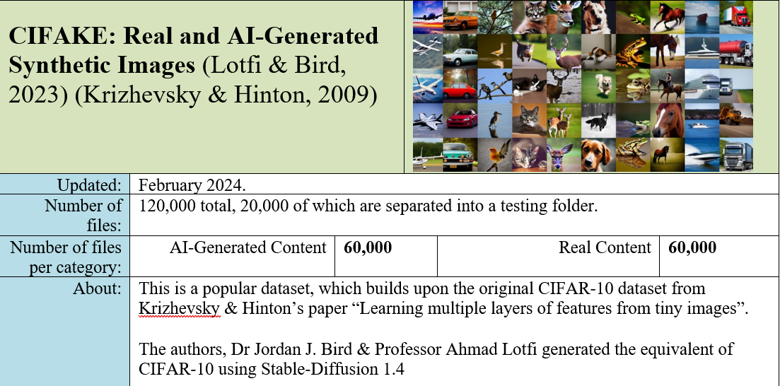

Slide 11
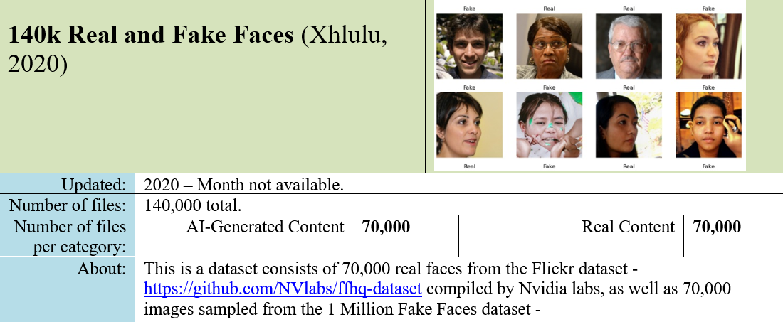

Slide 12
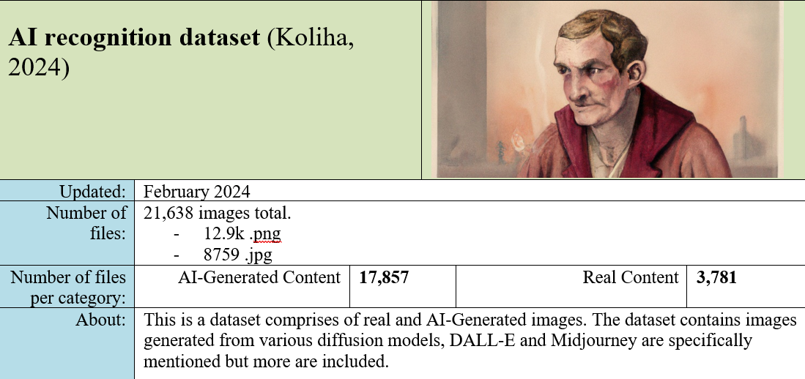

Slide 13
Data Preparation
Random data selector – Sample from raw dataset.
Data labbeling – AI-Generated v Real.
Random data splitting – Training, testing, evaluation.

Slide 14
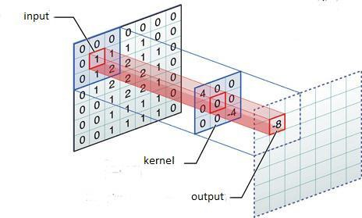
Implementation - Custom CNN
Basic CNN
Apply data split – training/validation
Filters images for feature extraction
Uses dropout to zero-out data, reduces overfitting
Flattens layers
Final layer single neuron, with sigmoid activation for binary classification

Slide 15
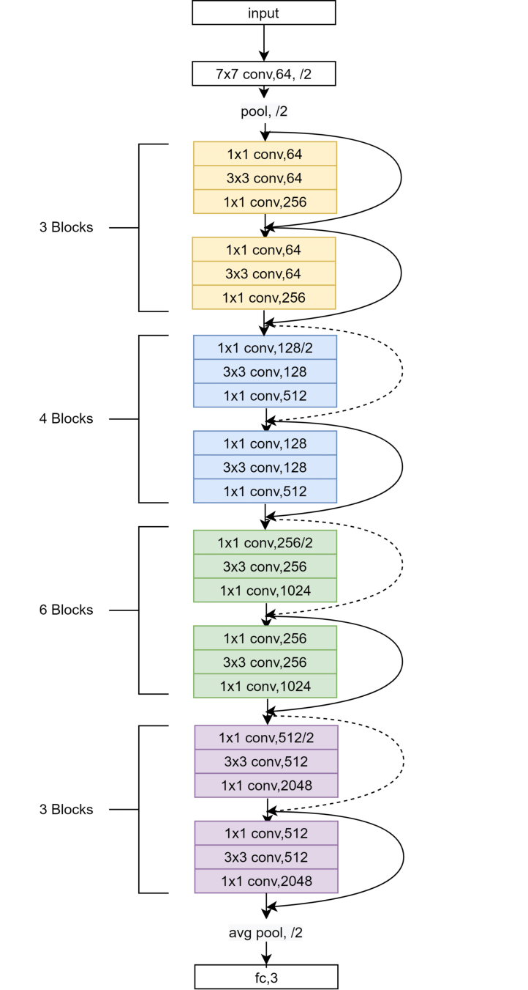
Transfer Model using Resnet50
Rescale images.
Apply data-split – training / validation.
Import ResNet50, pre-trained on ImageNet.
Increase epochs for training.
Still utilizing binary classification.
Implemented early stopping, saving the best model.

Slide 16
Model training / Validation Accuracy
Refined Model |  | Transfer Model
AI-Recog | Training Acc: 98.8% Validation Acc: 91.8% | AI-Recog | Training Acc: 68.2% Validation Acc: 74.2%
AI-Art | Training Acc: 96.7% Validation Acc: 65.6% | AI-Art | Training Acc: 54% Validation Acc: 55.6%
Artiface | Training Acc: 98.3% Validation Acc: 89.6% | Artiface | Training Acc: 68.2% Validation Acc: 71.7%
CIFAKE | Training Acc: 96.3% Validation Acc: 87.5% | CIFAKE | Training Acc: 71.3% Validation Acc: 70.7%
Faces | Training Acc: 94.7% Validation Acc: 73.3% | Faces | Training Acc: 56.9% Validation Acc: 56.9%

Slide 17
Key findings
Custom CNN
Some good results, some relatively poor. Generally the more diverse datasets confirmed higher accuracy.
Highest Accuracy on like-dataset (AI-Art) | Highest accuracy on random dataset (Artiface)
88.3% (AI – 76.6 / Real 100%) | 73.3% (AI – 81.1 / Real 65.5)
Transfer model
Extremely poor results, most datasets showed no skill, returning 50% accuracy. Only 1 dataset (CIFAKE) showed any skill, though low. 63.8% Accuracy – 30.8% AI / 96.8% Real

Slide 18
Conclusion
ML Models can be relatively effective. Showing some skill in certain cases and with further tweaking could be more effective.
Shadows, geometric inconsistencies, noise patterns etc. Dataset results show they aren’t really looking for objects or specific things in the image. More so characteristics.
The custom CNN returned far higher accuracy than the transfer model. Believe with a larger dataset and more time training the custom CNN could be quite accurate.

